Slide 1
MCA Major Project End Term Evaluation
BookEasy (Ticket booking system)
Under the guidance of
Dr Arpana Sinhal
Department of Computer Applications
Faculty of Science, Technology and Architecture
Manipal University Jaipur
By
Rani Kumari
23FS20MCA00116
2023-25

Slide 2
Outlines
Introduction
Motivation
Process model
Software requirement specification
Data flow diagram
Output
Conclusion
Future scope

Slide 3
1. Introduction
BookEasy - Online Ticket Booking System
BookEasy is a simple and easy-to-use website where people can book tickets online for movies, flights, buses, trains, concerts, and more. It saves time by letting users book from anywhere without standing in long lines.
The system ensures real-time seat availability, so users can see exactly which seats are free when booking. It also integrates secure payment gateways, making ticket purchases safe and reliable.
With BookEasy, users enjoy a smooth, efficient, and secure way to plan their travel and entertainment all in one place.
Key features of BookEasy:
Real-time seat availability: See which seats are available before booking.
Secure payments: Pay safely through trusted payment gateways.
Multiple services: Book tickets for travel, events, and entertainment in one place.
User-friendly interface: Easy navigation and quick booking process.
BookEasy makes ticket booking fast, safe, and convenient for everyone.

Slide 4
2. Motivation
In today’s fast-moving digital world, people want convenience, speed, and easy access when planning travel or entertainment. Traditional ticket booking methods for buses, trains, flights, movies, concerts, or dining often involve long waiting lines, mistakes, limited availability, and waste a lot of time.
The goal of creating an Online Ticket Booking System is to build a single digital platform where users can quickly search, compare, and book tickets across different categories anytime and from anywhere. By automating the booking process and bringing together many service providers into one system, this project aims to:
Get rid of long queues and manual work
Allow secure and instant bookings in real time
Offer a better user experience with personalized and updated information
Lower costs and reduce workload for service providers
Be ready to grow and connect with other services like Google Maps or online payments (e.g., UPI, PayPal)

Slide 5
3. Process Model: Incremental Model
Why Use the Incremental Model?
Divides the system into smaller, manageable increments (or modules).
Each increment delivers a working version of the system.
Feedback-based improvements are possible before the next release.
Phases of Incremental Model:
Increment 1 – User Authentication & Profile Management
User Registration/Login
Role-based access (User/Admin)
Increment 2 – Ticket Search & Selection
Browse events, movies, or travel options
Filter and sort based on price, availability, and category
Increment 3 – Booking & Payment
Seat selection and reservation
Secure online payment integration
Increment 4 – Notifications & Ticket Management
Email/SMS confirmations
Ticket cancellation and refund processing
Increment 5 – Reports & Admin Panel
User activity tracking
Sales and revenue reports
Each phase builds upon the previous one, ensuring a fully functional system by the end.

Slide 6
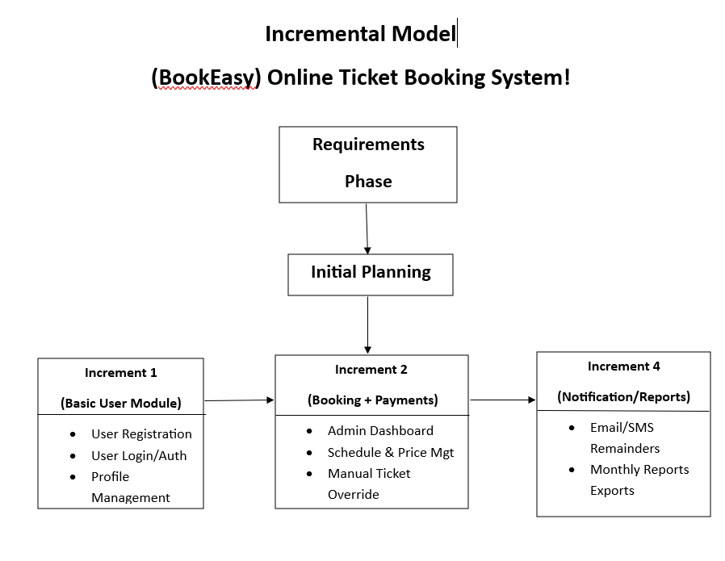

Slide 7
4. Software Requirement Specification (SRS)
Introduction • Purpose: Define requirements for BookEasy. • Scope: Multi-service booking (Travel, Hotel, Movie, Dining, etc.)
2. Audience & Definitions • Audience: Developers, Testers, Managers, Users • Terms: UI, API, DB, SRS
System Overview • Frontend: HTML, CSS, JS • Backend: Java (Spring Boot) • Database: MySQL • RESTful, responsive design
User Roles • Customer: Register, Book, Cancel, View • Admin: Manage users, services, bookings
Core Features • Auth system • Dynamic Booking Forms • Payment Simulation • Notification system • Ticket & invoice download

Slide 8
4. Software Requirement Specification (SRS)
Other Features • PNR status & seat availability • Train schedules • Order food during travel • SMS/Email confirmations
Interface Requirements • UI: Responsive, Mobile Friendly • Backend: Spring REST APIs (JSON) • DB: MySQL (via JPA/Hibernate) • SMTP for email
Admin Dashboard • View/manage all bookings • Cancel/refund handling • Add/edit/delete services • Export reports
Non-Functional Requirements • Fast (<3s response) • Secure (hashed passwords, CAPTCHA) • 99.5% uptime • Modular & scalable

Slide 9
4. Software Requirement Specification (SRS)
Tools & Tech Stack • HTML, CSS, JavaScript • Java Spring Boot • MySQL • SMTP / PDF Generator
Future Enhancements • Live Payment Gateway • AI travel suggestions • Real-time admin alerts • Chatbot assistance
Appendix • UI Wireframes • ER Diagram • API List • Sample Test Cases & Data

Slide 10
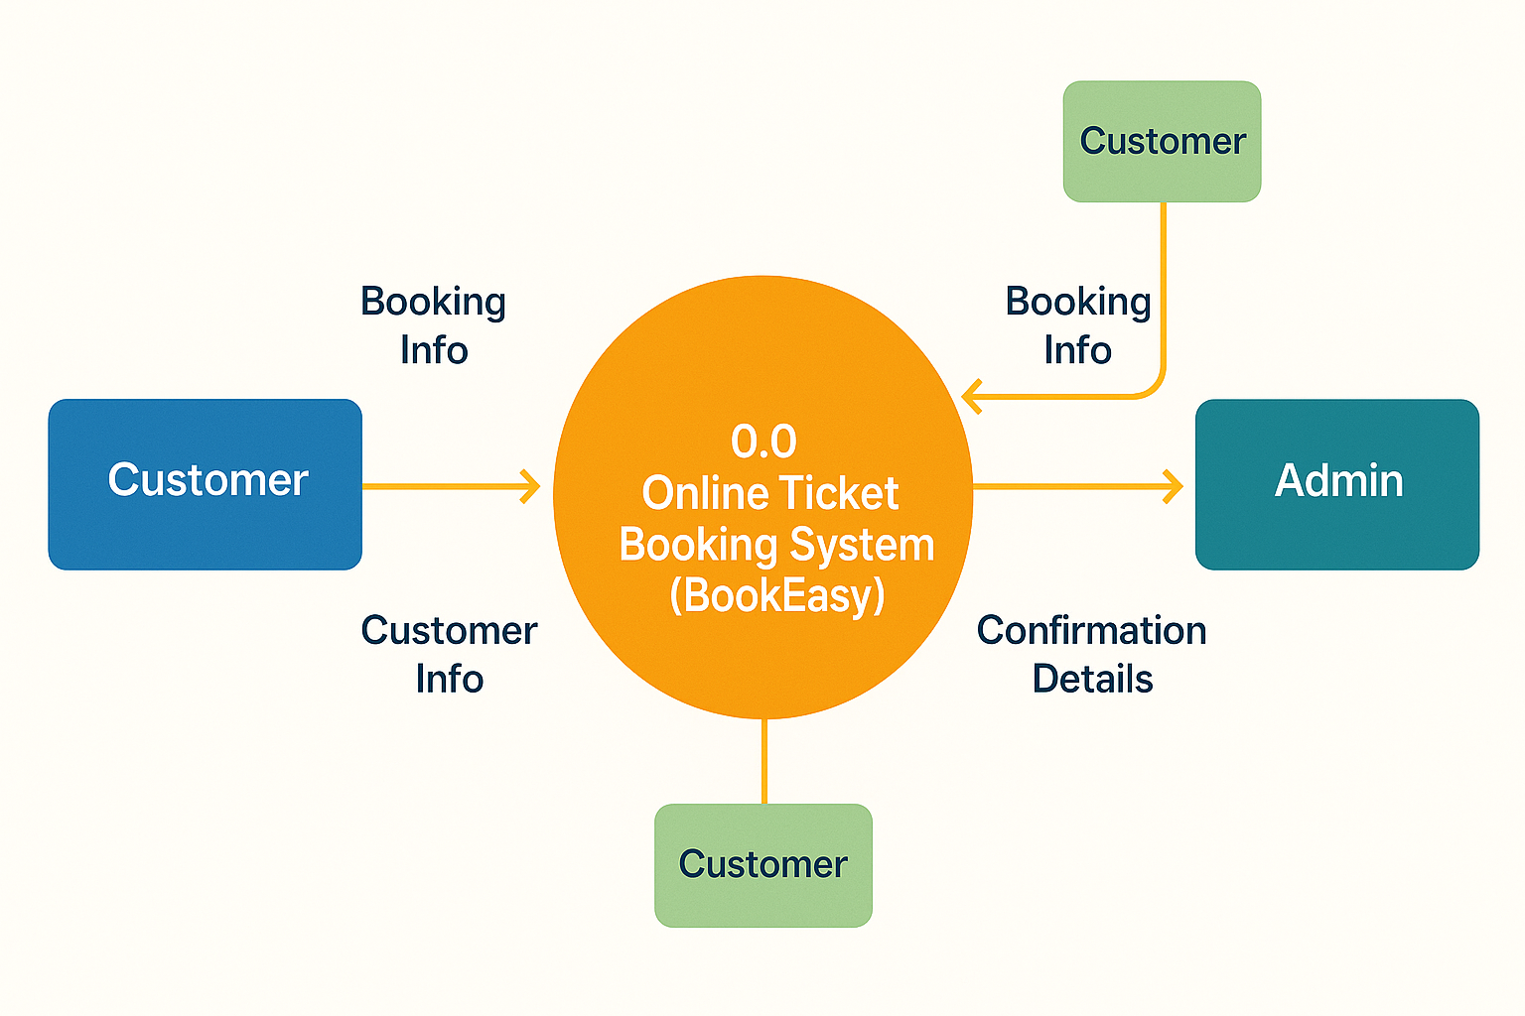
5. Data Flow Diagram (DFD)
0 Level Diagram

Slide 11
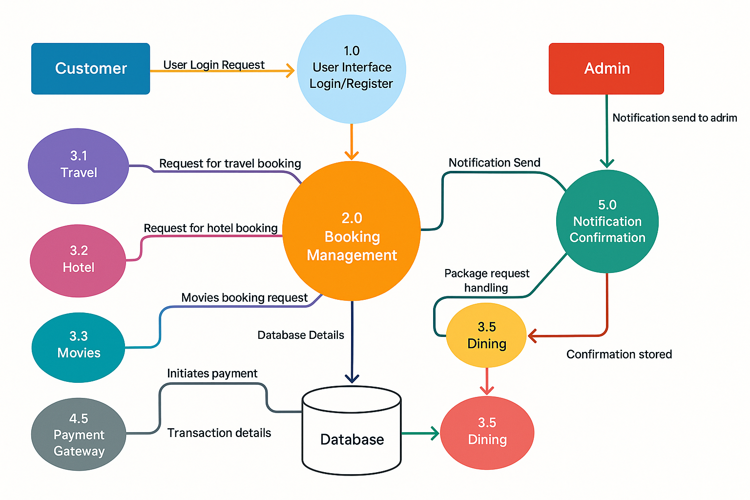
5. Data Flow Diagram (DFD)
1 Level Diagram

Slide 12
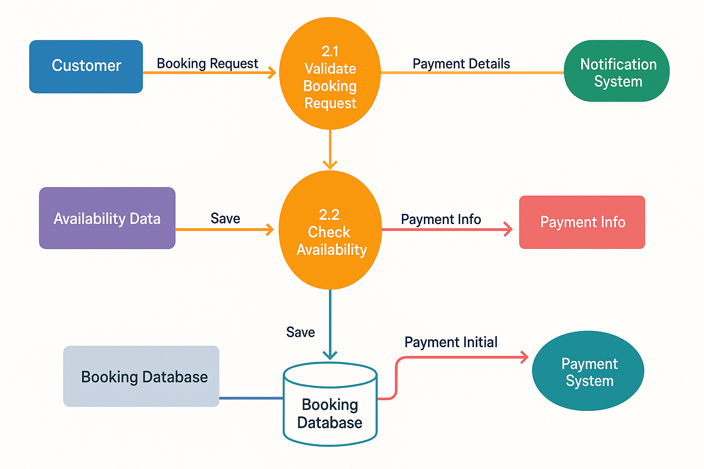
5. Data Flow Diagram (DFD)
1 Level Diagram

Slide 13
6. Output
1. E-Ticket / Booking Confirmation
Displays ticket details after successful booking.
Includes: Ticket ID, user name, travel/event details, seat/room info, amount paid, date & time.
Can be downloaded or emailed as a PDF or QR code.
2. Booking History Page
List of all past and upcoming bookings for the user.
Filterable by type: Bus, Train, Flight, Movie, Concert, Dining, Hotel.
Includes options for "Cancel", "Reschedule", or "Download Ticket".
3. Payment Status
Shows confirmation of payment success or failure.
Includes transaction ID, amount, and payment method.
Automatically updates the ticket booking status.

Slide 14
6. Output
4. Admin Dashboard Reports
Daily/weekly/monthly reports of:
Total bookings
Revenue generated
Cancellations
Most popular booking types
Graphical view (bar/pie charts) for better analytics.
5. Notification Output
On-screen confirmation messages.
Email/SMS alerts for booking, cancellation, refund, or reminders.
6. Invoice Generation
For bookings requiring receipts (flights, hotels, etc.)
Includes company logo, tax breakdown, and invoice number.

Slide 15
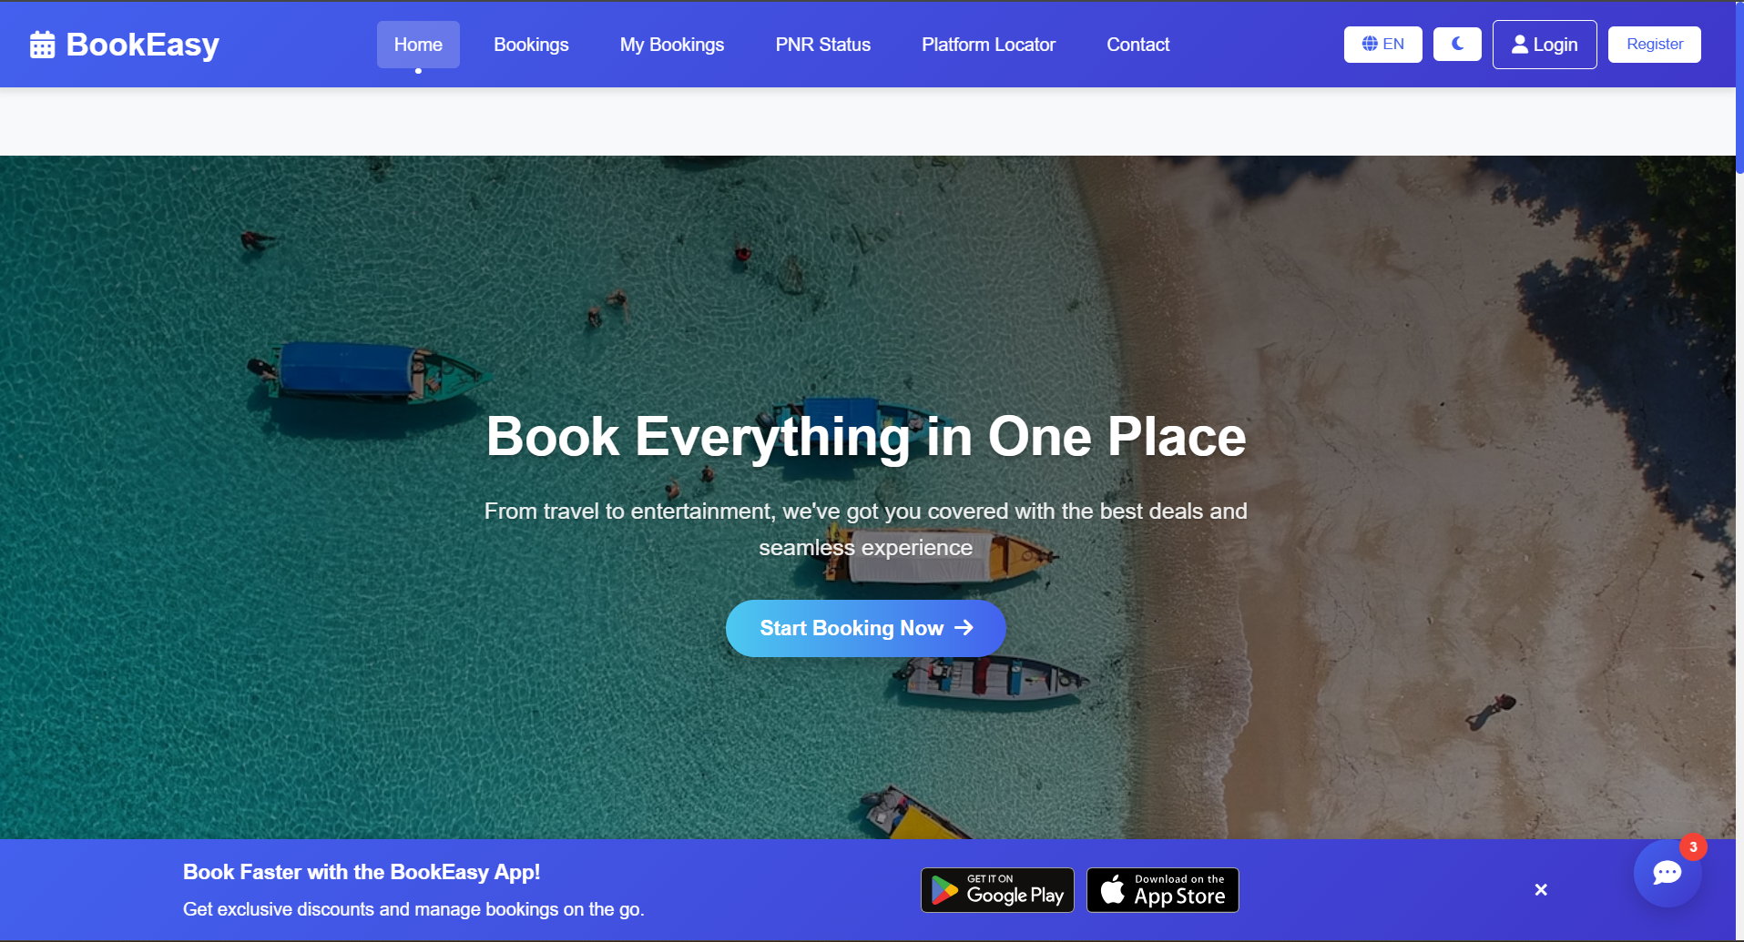

Slide 16
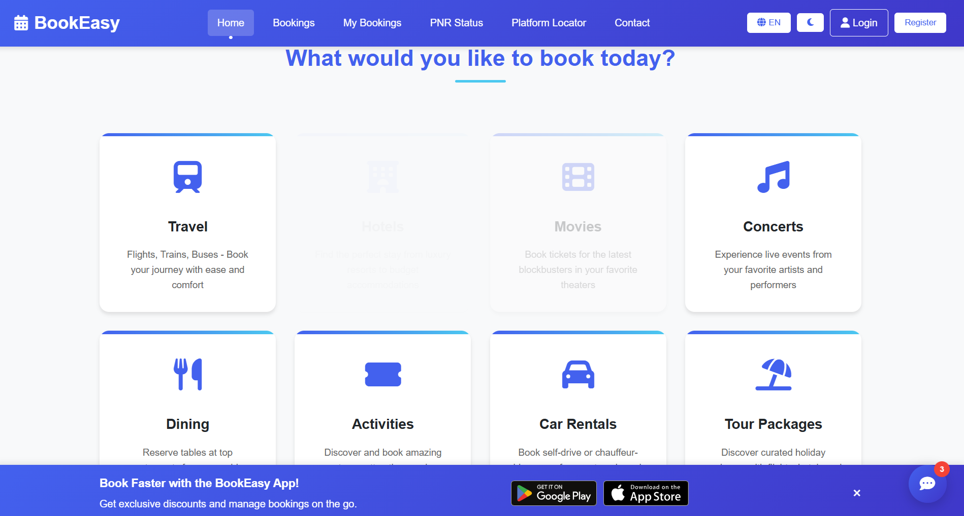

Slide 17
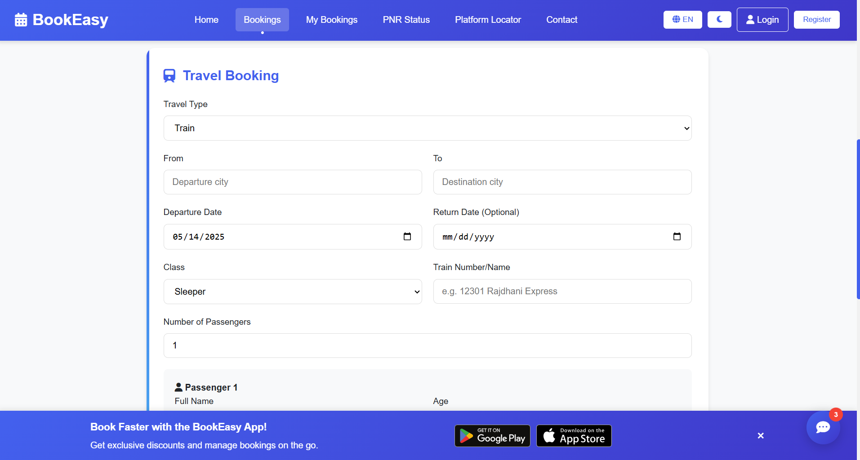

Slide 18
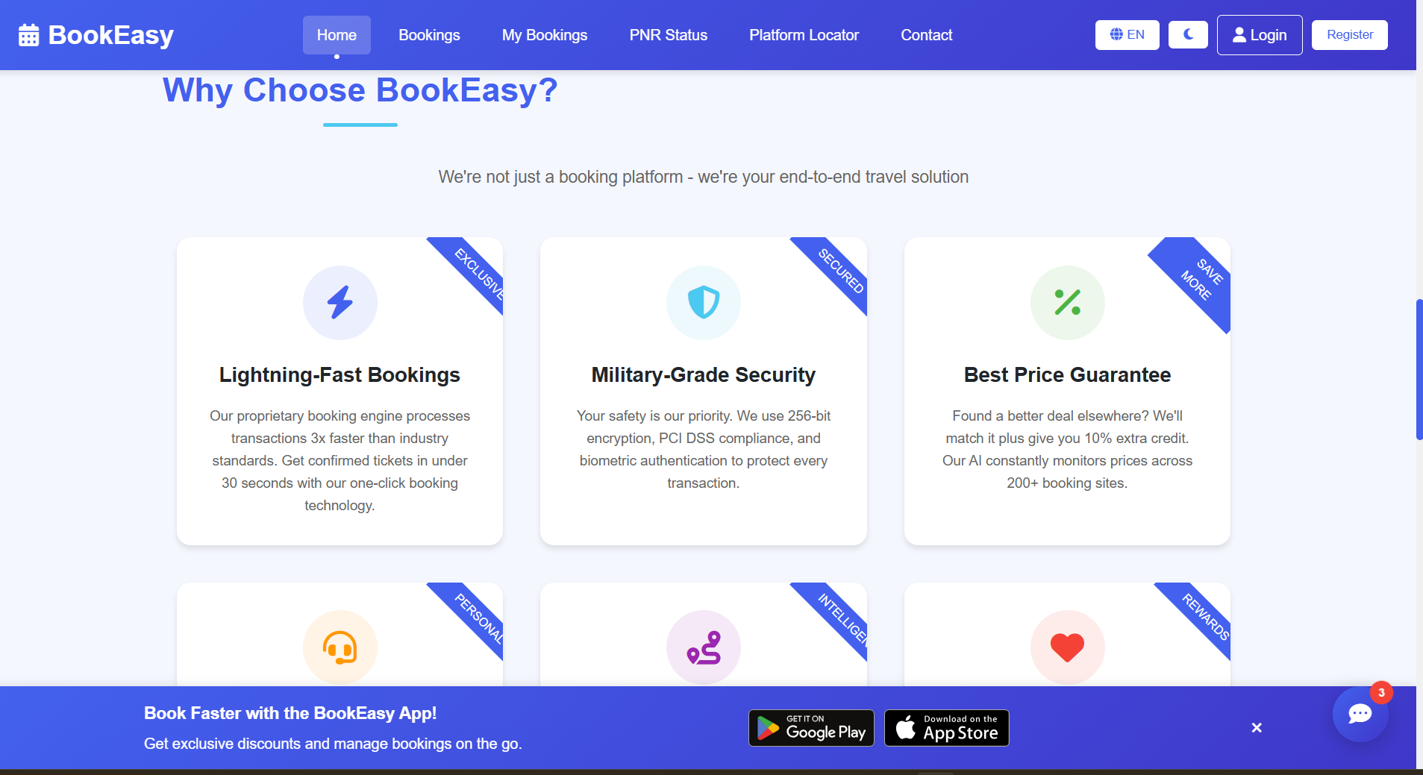

Slide 19
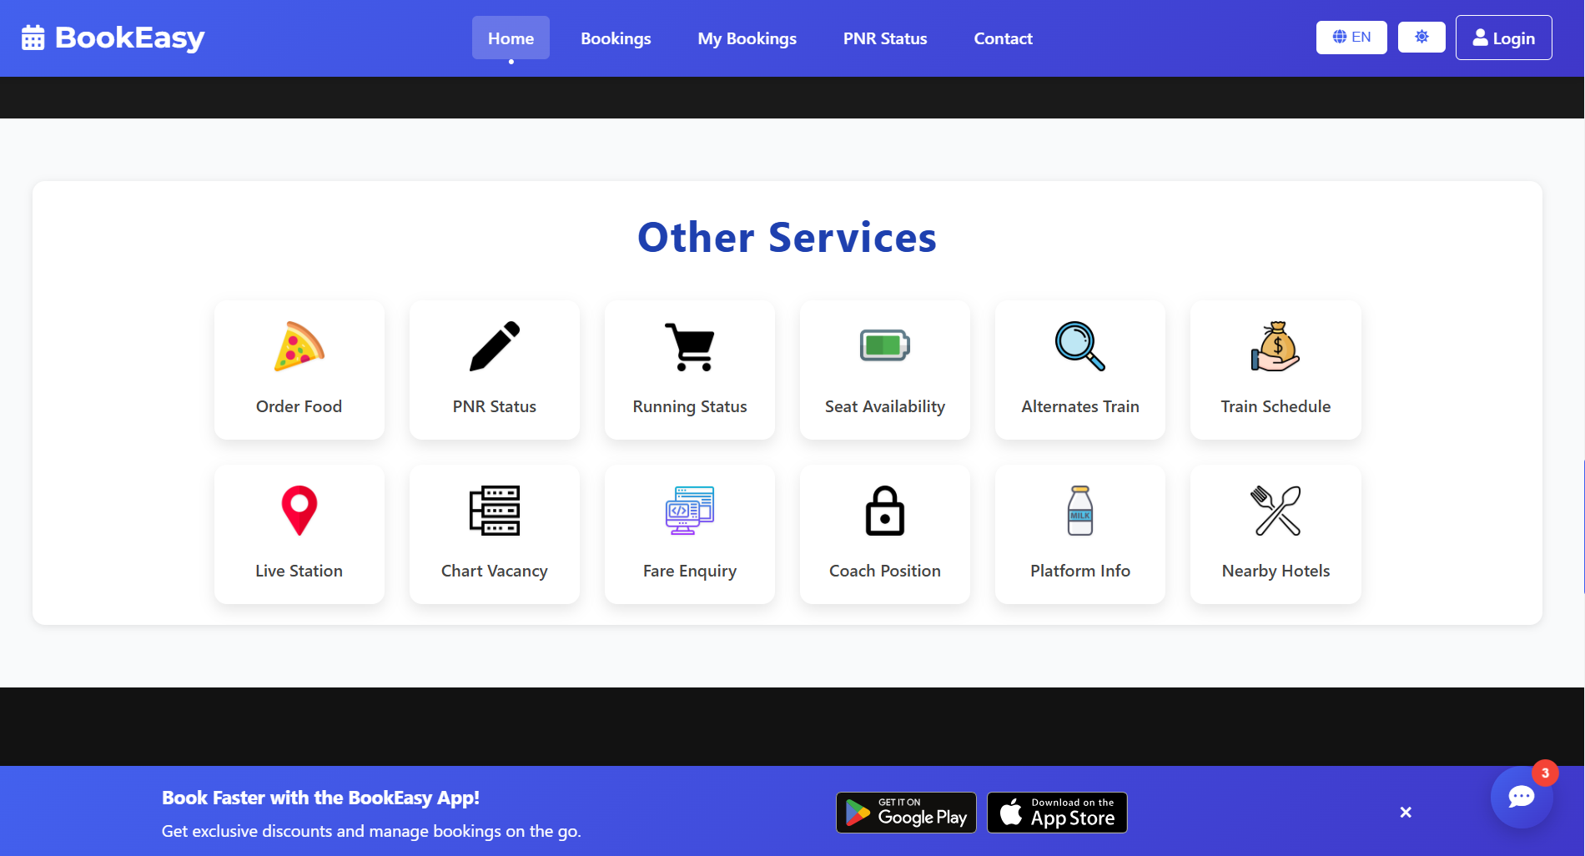

Slide 20
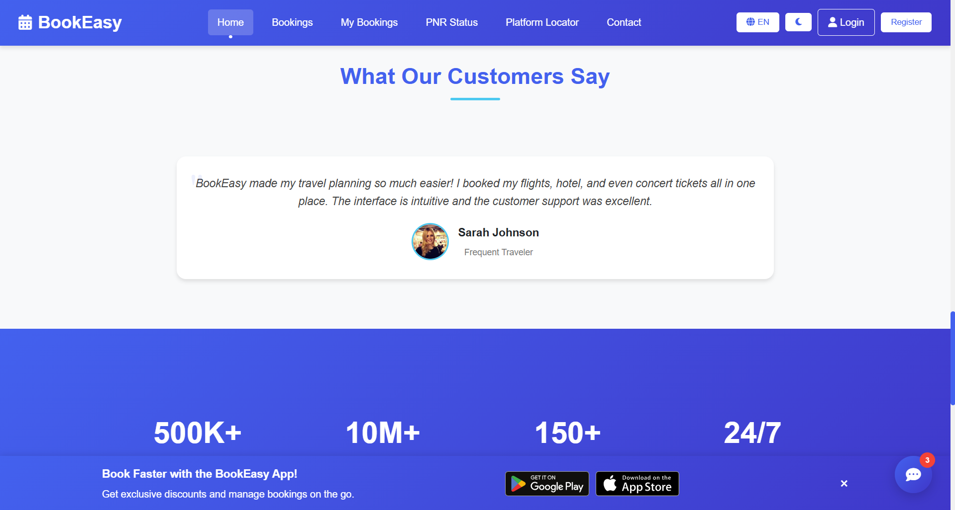

Slide 21
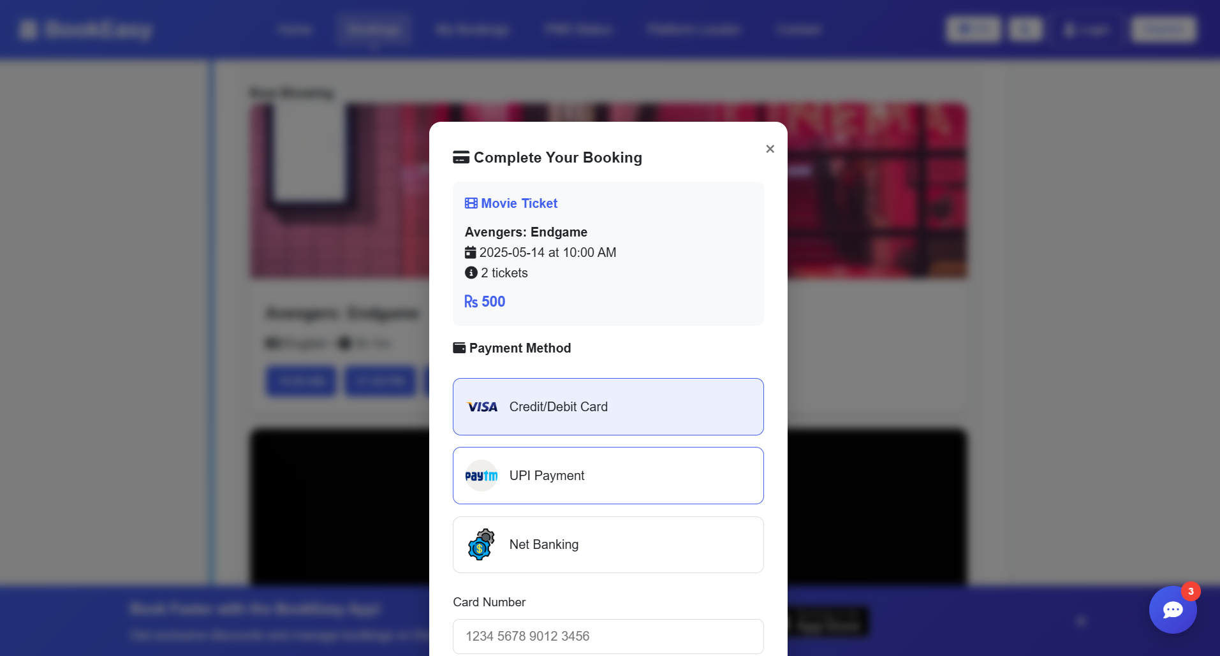

Slide 22
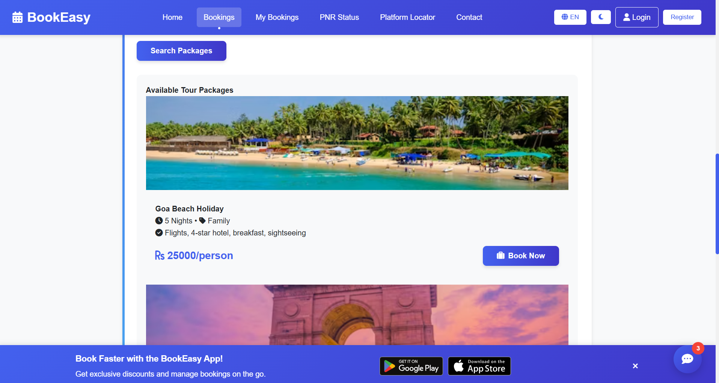

Slide 23
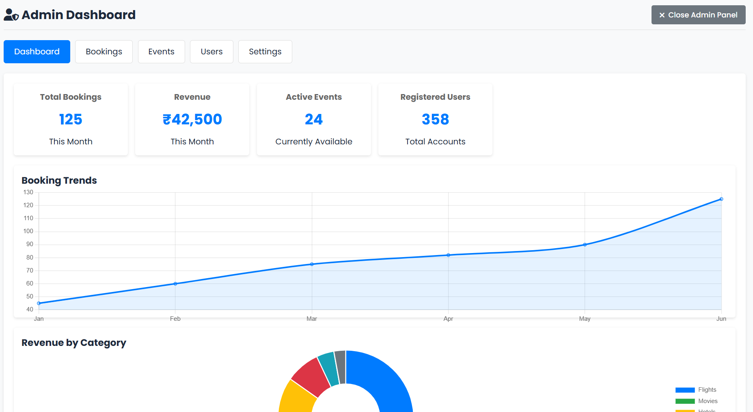

Slide 24
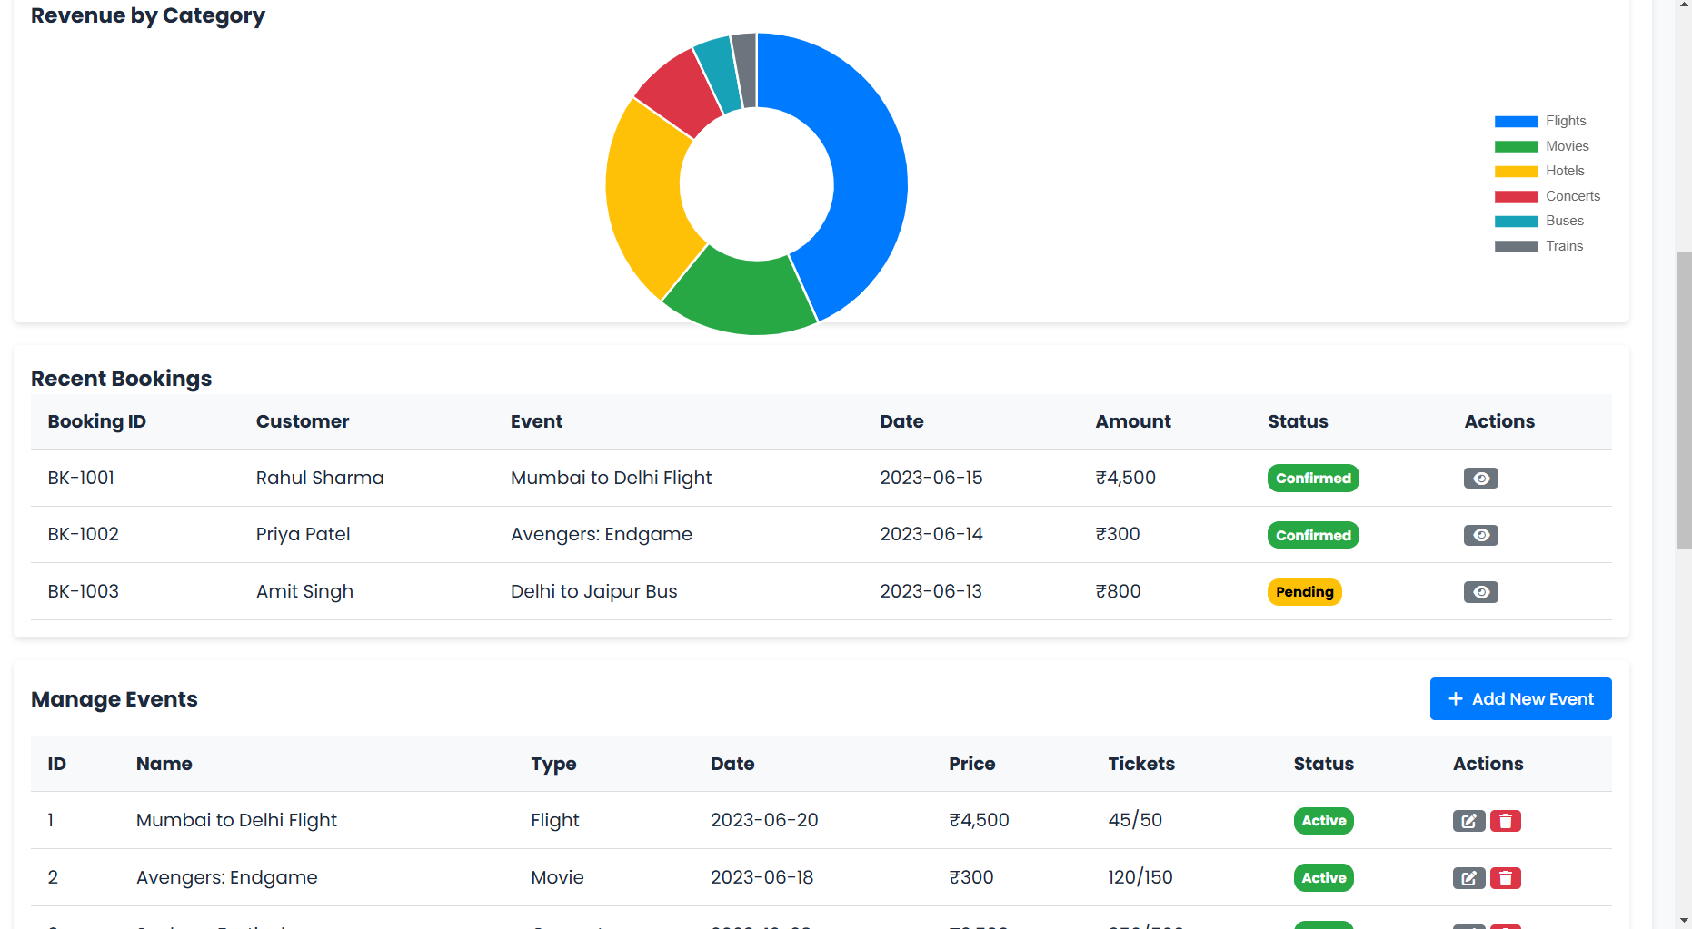

Slide 25
7. Conclusion
The Online Ticket Booking System provides a centralized and efficient platform for users to book various services such as bus, train, flight, hotel, dining, movies, and concerts from the comfort of their home. By digitizing the traditional booking process, the system offers a user-friendly interface, real-time availability, secure payments, and automated ticket generation.
This project not only simplifies the customer experience but also enables service providers to manage their schedules, pricing, and bookings more effectively. Through the use of modern development models like the Incremental Model, the system can be built and improved progressively, ensuring stability and flexibility.
The Incremental Model ensures continuous system improvements.
Reduces risk of failures by delivering features in phases.
Provides a seamless ticket booking experience with secure transactions.

Slide 26
8. Future Scope
1. AI & Personalization
Smart Recommendations based on user behavior, travel history, and preferences.
AI-based dynamic pricing for predicting the best time to book.
Chatbots for 24/7 customer service and booking assistance.
2. Global & Multi-Language Support
Expansion to international bookings.
Support for multi-language and multi-currency transactions.
Geo-localized content and offers for better user experience.
3. Emergency & Health Integration
Real-time health/safety alerts for destinations.
Travel insurance, refund automation during emergencies or cancellations.
4. Subscription Models & Memberships
Premium users get early access, discounts, or exclusive offers.
Monthly/yearly travel passes or dine-out plans.

Slide 27
Thank You

